Slide 1

Senior Meeting #2
Graduation
Wednesday, October 9th, 2024

Slide 2
Graduation
Thursday, May 22nd at 8:00 pm at Hardin Stadium
Grades
  Honors- You must have an 89.5 or above (weighted)
    There is NO ROUNDING UP
Gowns
  White Gowns= Honors Graduates
  Blue Gowns= Graduates
  ***Please note that if you choose to have your Senior Pictures taken in a white gown it does not mean that you will graduate in a white gown if you do not make the Honors threshold. You gown will be switched out for blue.

Slide 3
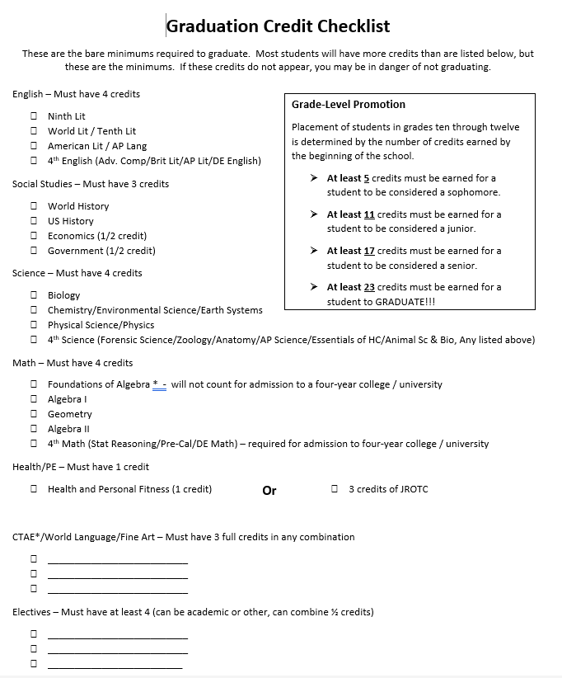
Graduation Credits
To graduate, you must have at least 23 of the right credits to graduate. Please make sure that you check-in with your guidance counselor to make sure that you are on track if you do not know.
DO NOT WAIT! Click here to see the posted graduation requirements or reference to the checklist listed to the right.
To make an appointment with your Guidance Counselor go through the PCHS Counseling page or make an appointment by clicking here.

Slide 4
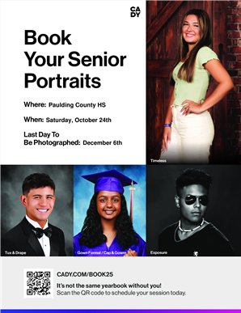
Senior Portraits
If you have not already done so, please make sure that you get your Senior Portraits taken!
The last Senior Portrait Road Show will be on Saturday, October 24th at PCHS. You must have an appointment to participate on this day.
If you have any concerns or questions about Senior phots, please contact Mr. Michael Young, Yearbook Advisor, at myoung@paulding.k12.ga.us
Click here to make your appointment!

Slide 5
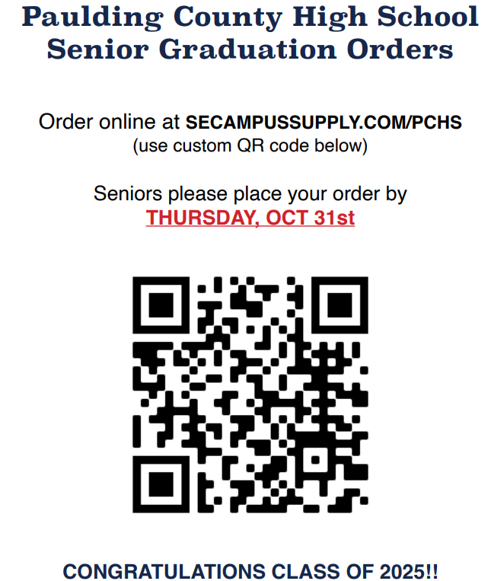
Ordering Caps and Gowns

Slide 6
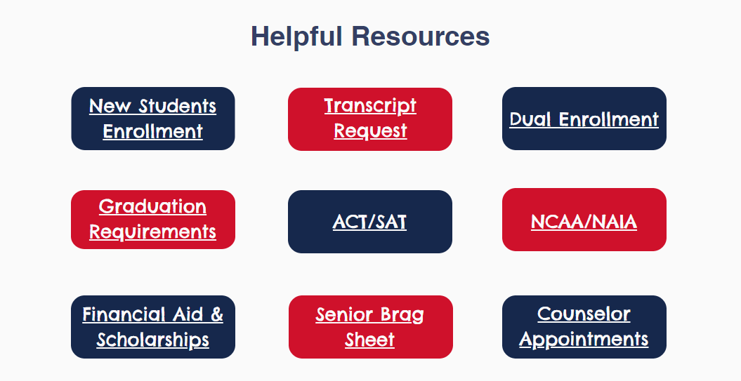
Requesting Transcripts
Please utilize the PCHS Counselors website this year for all things graduation and college. You can access the website by clicking here.
Scroll down to ‘Helpful Resources’
You can request transcripts for both In State or Out of State colleges through this site. Click here

Slide 7
Letters of Recommendation
If you took Mrs. Ali’s AP Lit Class:
    Email her Brag Sheet to your counselor.
If you did not take Mrs. Ali’s AP Lit Class:
    Go to the PCHS Counselors website by clicking here.
    Scroll down to ‘Helpful Resources’
You can fill out your Senior Brag Sheet here or click on this link.

Slide 8
Other Information
Senior Letters
Make sure that you get these signed and bring these back to your assigned counselor as soon as possible.
Financial Aid/Scholarships
To learn about Financial Aid and Scholarships click here.
Staying Up to Date
Senior Information click here
Paulding County High School Facebook page
Senior Instagram (@pchs.news)

Slide 9
Have anymore questions? Email us!
Heather DeJohn-Mathis
  Senior Administrator
  hdejohnmathis@paulding.k12.ga.us
Matt Goodison
  Senior Advisor
  mgoodison@paulding.k12.ga.us
Karmel Moulder
  Graduation Coordinator
  karmelb.moulder87@paulding.k12.ga.us

